Slide 1

G2M Case Study
Virtual Internship
30 Sep – 30 Dec 2022
LISUM14
Username: alassirifatima@gmail.com

Slide 2
Background –G2M(cab industry) case study
XYZ is a private equity firm in US. Due to remarkable growth in the Cab Industry in last few years and multiple key players in the market, it is planning for an investment in Cab industry.
Objective : Provide actionable insights to help XYZ firm in identifying the right company for making investment.
The analysis has been divided into four parts:
Data Understanding
Forecasting profit and number of rides for each cab type
Finding the most profitable Cab company
Recommendations for investment

Slide 3
Data Exploration
24 Features( including 9 derived features)
Timeframe of the data: 2016-01-31 to 2018-12-31
Total data points :355,032
Assumptions:
Outliers are present in Price_Charged feature but due to
unavailability of trip duration details ,we are not treating this as outlier.
Profit of rides are calculated keeping other factors constant and only
Price_Charged and Cost_of_Trip features used to calculate profit.
Users feature of city dataset is treated as number of cab users in the city.
we have assumed that this can be other cab users as well(including Yellow and
Pink cab)
Cab_Data.csv
Customer_ID.csv
Transaction_ID.csv
City.csv
Final cab data

Slide 4
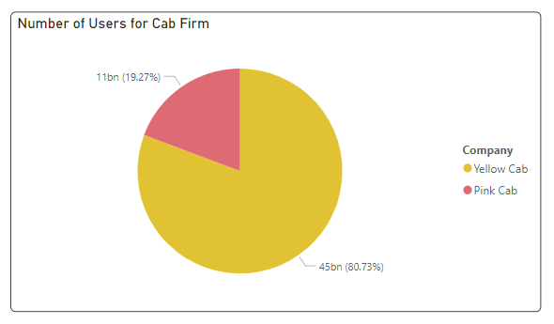
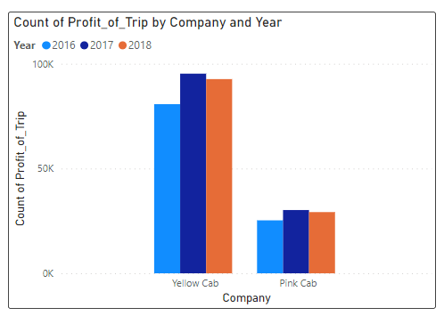
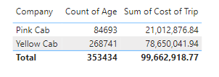
Profit Analysis
Users Analysis

Slide 5
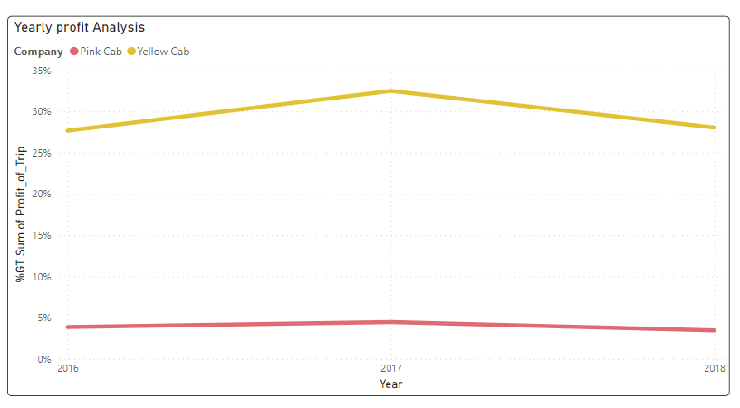



Yearly Profit Analysis
The Yearly Profit Analysis for Yellow Cab is higher than Pink Cab
In 2017, the highest present for Yellow Cabs (32.49%) and Pink Cabs (4.48%)

Slide 6
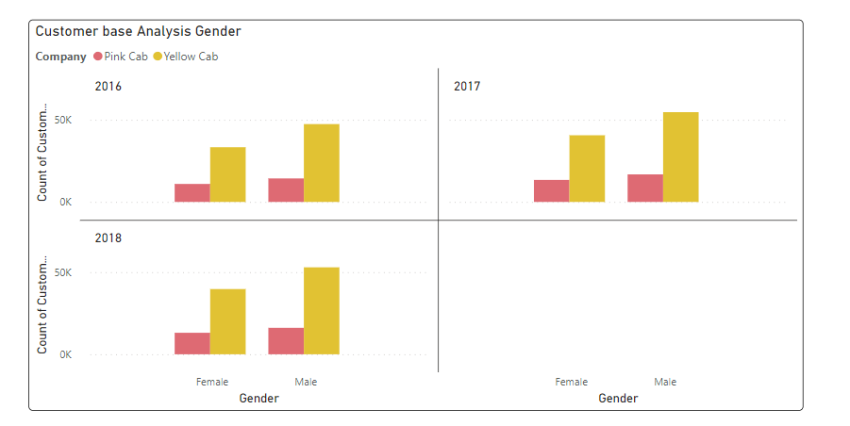
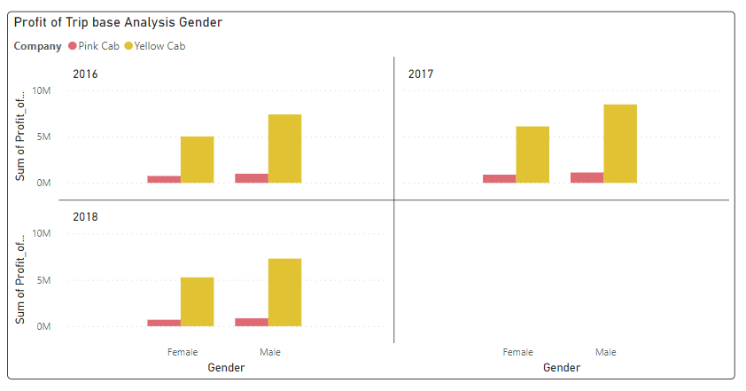
Profit and customer base Analysis Gender wise
There is almost equal distribution of gender in the Profit and customer base of both the cabs.

Slide 7
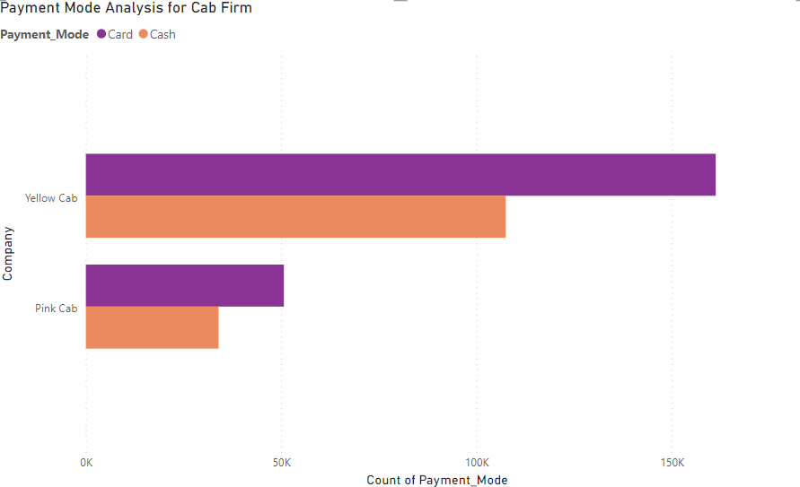




Payment Mode Analysis for Cab Firm
Payment Mode in Cab firm the Yellow Cab has a higher count than Pink Cab.

Slide 8
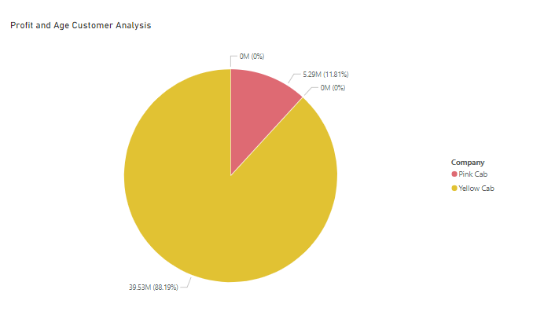
Age GroupWise Profit And Customer Base Analysis
As Different Ages of Costumers, they Favor the Yellow Cab.

Slide 9
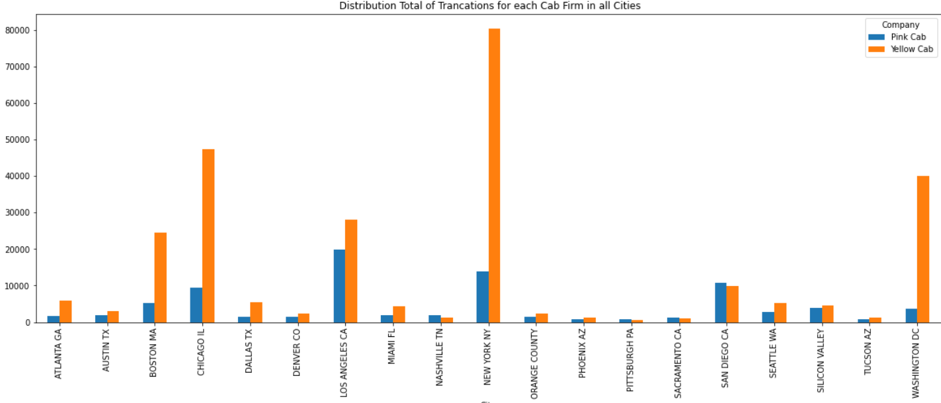
City Wise Cab Users Covered By Company
This is the number of users covered by Yellow and Pink cab
In the city against all cab users present In the city

Slide 10
Customer Presence of Yellow and Pink cab city wise
Out of 19 Cities Yellow cabs have higher customer reach compared to Pink cab, in the following 4 cities:
New York, Chicago , Washington, and Los Angeles

Slide 11
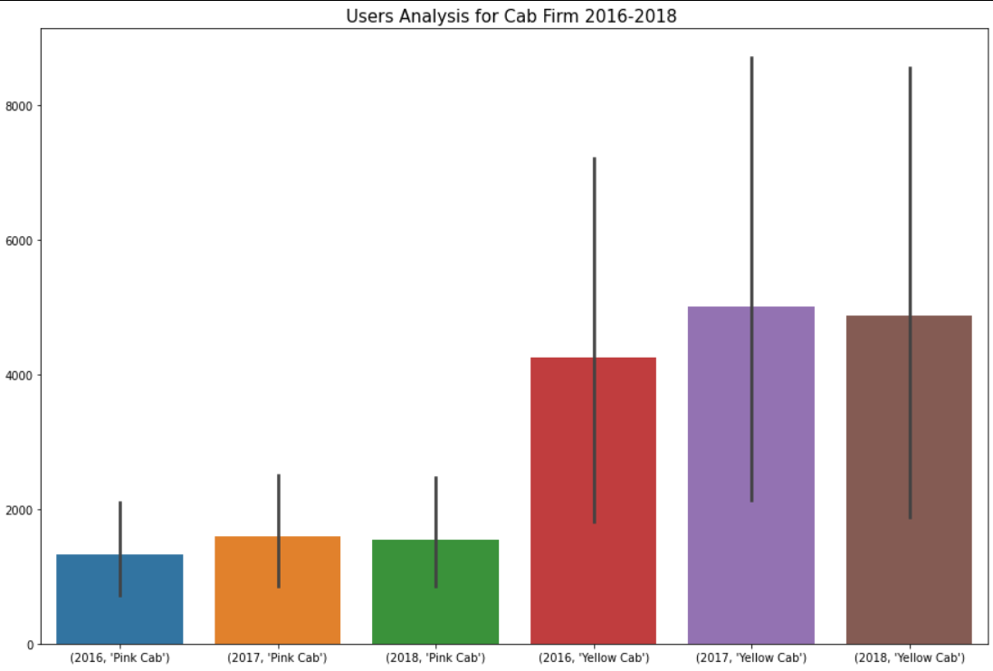
User Covered by Company and Customer base Year wise
We have considered all cab users present in 19 cities to calculate Yellow and Pink cab coverage.
Yellow cabs higher customer base as compared to Pink cab.
There is a 1.3% loss in the customer count of Pink cab from 2017-2018 and for the same period
Yellow cab lost 1.14%

Slide 12
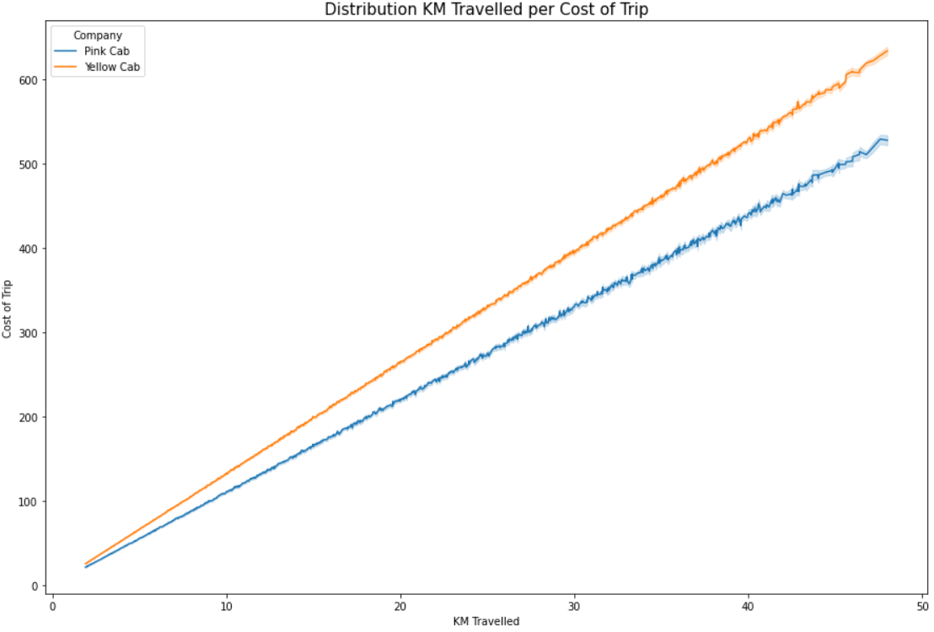
Distribution KM Travelled per Cost of Trip
The Yellow Cab is higher than Pink Cab
Users trust Yellow Cab more, especially on long trips, and this results in more cost to the user and more profit for the company

Slide 13
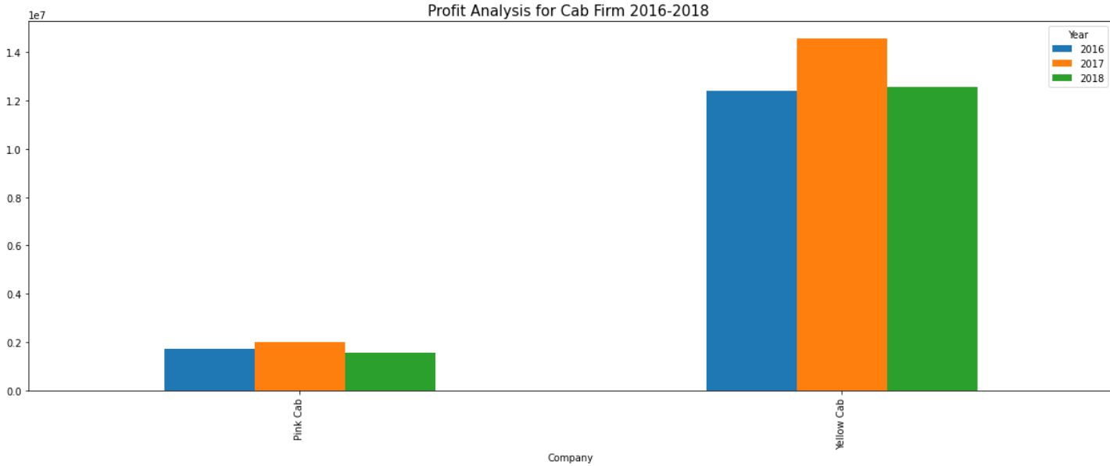
Profit Analysis for Cab firm 2016 -2018

Slide 14
Recommendations
We have evaluated both the cab companies on the following points and found Yellow cab better than Pink cab:
Customer Reach: Yellow cab has a higher customer reach in 25 cities while Pink cab has a higher customer reach in 4 cities. We have also observed that Yellow cab is doing good in covering other cab users as compared to Pink cab.
Customer Retention: We have analyzed this in two segments: at least 5 drives and at least 10 drives with the same cab company. And we found that Yellow cab is doing far better than Pink cab in both these segments.
Age-wise Reach: Yellow cab has customers in all age groups, and it’s been observed that it’s even popular in the 60+ age group as equally as it’s in the 18-25 age group.
Average Profit per KM: Yellow cab’s average profit per KM is almost three times the average profit per KM of Pink cab.
Income-wise Reach: Both the cabs are very popular in high and medium-income classes but here also Yellow cab is performing better than Pink cab in offering their services to all three income class groups (low, medium, and high)
Ride count and Profit Forecasting: Both companies are facing loss in profit and no. of rides. Yellow cab’s forecasted profit loss is around 1.83% while Pink cab’s loss is 3.1%. The pink cab is facing more loss even when its forecasted no of ride loss is lesser than the Yellow cab.
Based on the above point, we will recommend Yellow cab for investment.

Slide 15
30 Sep – 30 Dec 2022
LISUM14
Username: alassirifatima@gmail.com
Thank You

